Slide 1
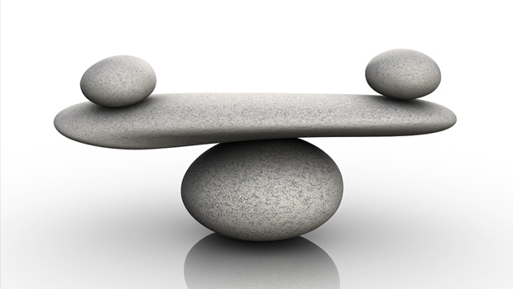
Regulation of the Cardiovascular system
Professor Deepthi de Silva
Department of Physiology

Slide 2
At the end of this lecture you should be able to
Outline the need for regulation of the CVS
Outline the mechanisms involved in local regulation of flow and autoregulation
Outline giving examples, substances that act locally to alter tissue flow
Outline the role of hormones in the systemic regulation of the CVS
State the mechanism of action of the catecholamines and angiotensin II
Outline the role of the autonomic nervous system in regulating blood vessels and the heart
Outline the role of the baroreceptor reflex in short term regulation of blood pressure
Outline the basis of the valsalva manoeuvre

Slide 3
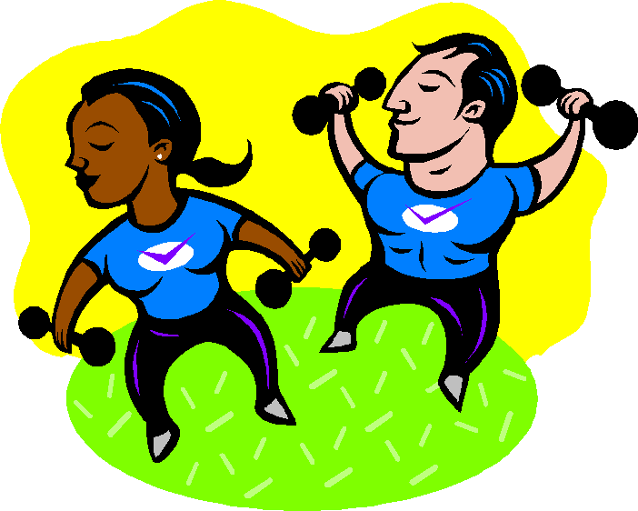
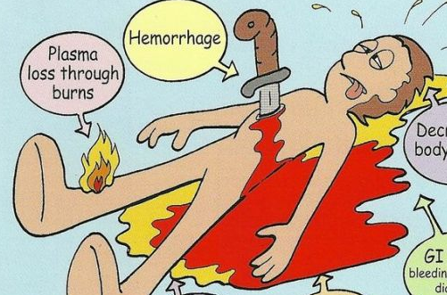
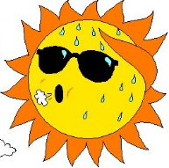
Why is the cardiovascular system (CVS) regulated?
Adjust blood flow according to tissue needs
  e.g. Increase flow to exercising muscles
Maintain blood supply to vital organs (brain, heart) in times of stress
  e.g. Bleeding (haemorrhage)
Maintain body temperature
  ↑body temperature - send blood to skin to enable heat loss

Slide 4
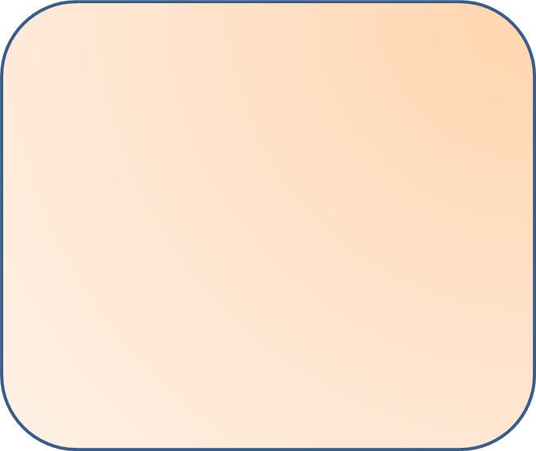
CVS regulation
Local
Systemic
Short
term
Long
term
Neural
Humoral

Slide 5
Local Regulation –
1. Tissue blood flow
As tissue metabolism
increases, blood
flow increases
Mechanism
  Direct
  Indirect
Examples
  Muscle blood flow in exercise
Reduced tissue oxygen/
Nutrients
Release of vasodilator
substances
Act on metarterioles &
precapillary sphincters

Slide 6
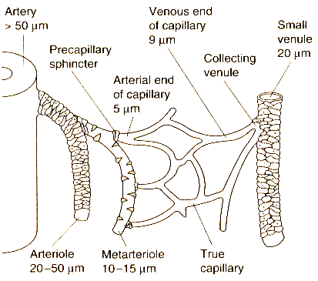

Slide 7
2. Regulation of organ specific flow- Autoregulation
Organs can maintain a constant rate of blood flow even when the blood pressure changes (e.g. Brain, kidney)
Acute
0.5 1.0 1.5 2.0
Blood flow
Long term
0 50 100 150 200 250
Arterial pressure (mmHg)

Slide 8
Mechanisms for autoregulation
Metabolic theory
Myogenic theory
Reduced blood flow causes accumulation of vasodilator substances
Increased blood pressure stretches smooth muscle which then contracts

Slide 9
Locally acting
Vasodilators
Locally acting
Vasoconstrictors
Reduction of
  Oxygen & pH
Rise in
  Osmolality
  pCO₂ (brain, skin)
  Temperature
  Potassium
  Lactate
  Histamine
  Adenosine (in cardiac muscle)
Damaged vessels have capacity to vasoconstrict
  Serotonin helps this
Fall in temperature

Slide 10
Endothelial secretions
Endothelial cells secrete
  Growth factors
  Vasoactive substances
Vasoactive substances include
  Prostacyclins (vasodilator)
  Nitric oxide (vasodilator)
  Endothelins (vasoconstrictor)
  Carbon monoxide (vasodilator)

Slide 11
Prostacyclin
Arachidonic acid derivatives using cyclo-oxygenase pathway
Prostacyclin from endothelial cells
  Vasodilatation and inhibits platelet aggregation
Thromboxane A₂ from platelets
  Vasoconstriction and platelet aggregation
Arachidonic acid derivatives using cyclo-oxygenase pathway
Both act to balance clot formation while avoiding excessive extension of clots

Slide 12
Aspirin
Irreversible inhibition of cyclo-oxygenase
Aspirin alters balance towards prostacyclin
  Endothelial cells rapidly form PC;
  Platelets unable to form thromboaxe A₂ (need new platelets to form :takes ∼4days)
Aspirin used to prevent clot formation especially in the arterial circulation (i.e. prevention of heart attacks, strokes)

Slide 13
Nitric Oxide
Formed by endothelial cells
Acts as a messenger to cause vasodilatation in smooth muscle
Discovery awarded Nobel prize for Physiology or Medicine in 1998
Arginine
Nitric oxide
synthase
NO
Guanylyl cyclase
GTP
cGMP
Smooth muscle
relaxation

Slide 14
NO functions
Cause arterial dilatation when local flow increases
  Other substances can act via NO (Ach, bradykinin)
  Some vasoconstrictor substances also stimulate secretion of NO
Secreted by intact endothelium by factors released by platelet aggregation
  damaged endothelium, NO not formed – vasoconstriction occurs
? Role in maintaining normal blood pressure
Vascular remodelling and angiogenesis-
  ? Role in atherosclerosis
Role in male sexual response

Slide 15
Long term local regulation of flow
Adaptations for the regulation of long term flow
  Increase the number/ size of vessels
  Stimulated by tissue O₂ requirements
Collateral circulation
  Pre existing vessels dilate to allow blood flow when there is an obstruction to flow
  (important in the coronary circulation)

Slide 16
Humoral Regulation
Chemical substances transported in blood
Vasoconstrictors
Catecholamines
Angiotensin II
Vasopressin
Vasodilators
Histamine
Prostaglandins | Some types
ANP, BNP
Others | K ⁺, Citrate, Acetate

Slide 17
Catecholamines
1. Adrenaline
  from adrenal medulla
  May cause vasodilatation in skeletal muscle/ liver
2. Noradrenaline
  Post ganglionic sympathetic neurotransmitter; mainly exerts effects via neural regulation

Slide 18
Sympathetic nervous system
Neural
Humoral
Noradrenaline
Mainly via sympathetic
nerve ending
Adrenaline
[& Noradrenaline]
from adrenal medulla
Heart
Chronotropic & Inotropic effects
β1 Receptors
Arterioles and Veins
Vasoconstriction/
vasodilatation
α1,2 Receptors
β2 Receptors

Slide 19
Angiotensin II
Angiotensinogen
Renin
Acts on arterioles to increase total peripheral resistance
ACE inhibitors used to treat hypertension
Angiotensin I
ACE
Angiotensin II
Short term
Long term
Vasoconstriction
Aldosterone
(Na+/ water
retention; thirst)
Angiotensin
converting enzyme
Elevate BP

Slide 20
Vasopressin
(Anti diuretic hormone)
From hypothalamus via the posterior pituitary
At high concentrations, act as a powerful vasoconstrictor

Slide 21
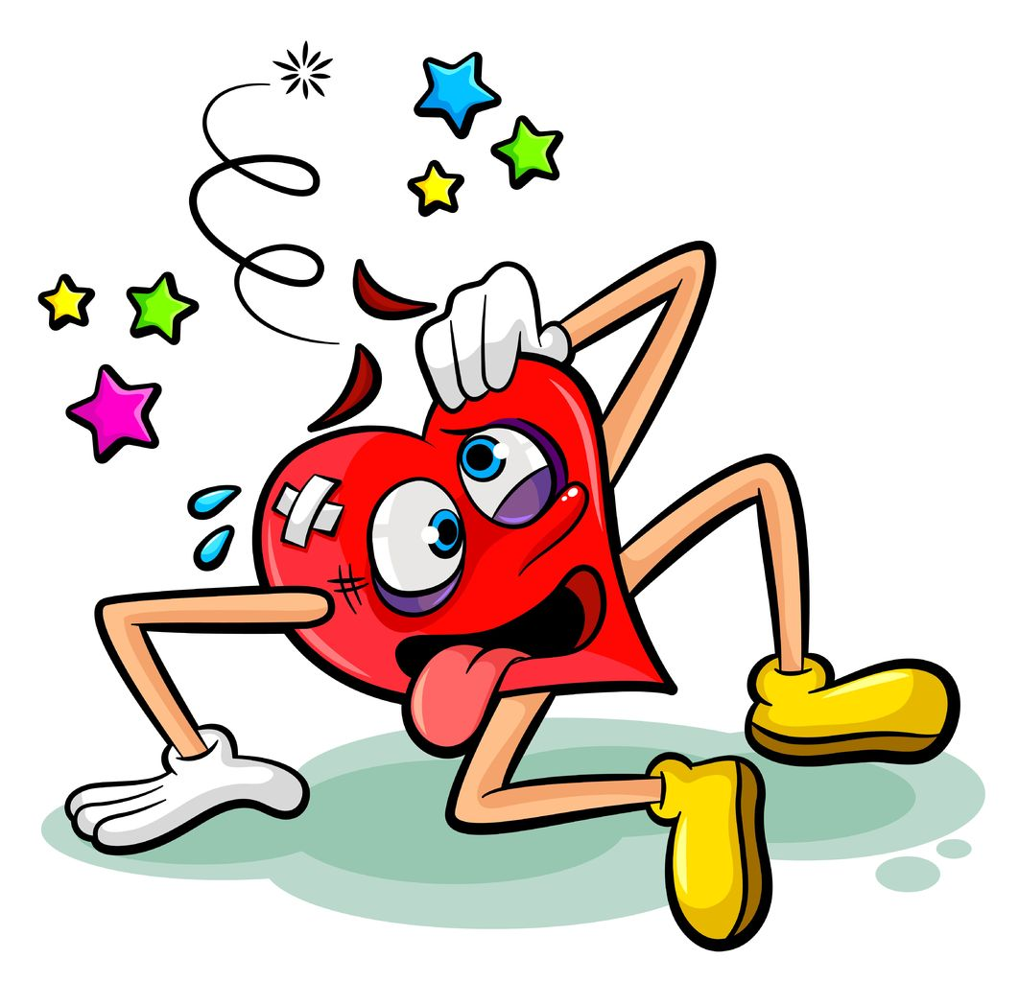

Slide 22
Neural Regulation
Important for the global regulation of the circulation
Rapid method of regulation
Enables
  Distribution of blood according to body requirements
  Regulation of the heart (chronotropic and inotropic) function
  Rapid control of the blood pressure

Slide 23
Factors regulating blood pressure
Short term regulating mechanisms
  Mainly neural
Long term regulating mechanisms
  Adjust the body fluid volume
  Mainly humoral (this will be covered in the lectures on shock; and the urinary module)

Slide 24
Short-term regulation
Baroreceptors
Chemoreceptors
Hormonal mechanisms
Intrinsic vascular mechanisms
  Capillary fluid-shift system
  Stress-relaxation

Slide 25
Baroreceptor reflex in BP regulation- an overview
Important in the short term regulation of BP
  E.g. In maintaining BP during changing position from sitting to standing
  Baroreceptors are most useful for short term regulation of BP in the pressure range of 70 – 150 mmHg
    Prolonged elevated blood pressure causes re-setting of the system

Slide 26
Rise in BP
Detected by baroreceptors
Afferents via IX & X
Medulla oblongata
Reduce Sympathetic discharge to CVS
Increased parasympathetic discharge to heart
Fall in BP

Slide 27
Autonomic nervous system
Sympathetic
Parasympathetic
Heart
  Increase heart rate
  Increase contractility
Blood vessels
  Arteriolar constriction increases resistance to flow
  Venoconstriction increases venous return
Heart
  Reduces heart rate
Blood vessels
  Minimal effect

Slide 28
Sympathetic action on heart
Post ganglionic fibres release Nadr
Act on β1 receptors
  SAN increase rate of depolarisation
  AVN reduce delay
  Myocardium to increase inotropic action
Parasympathetic action on heart
Post ganglionic fibres release Ach
Act on muscarinic receptors
  SAN decrease rate of depolarisation
  AVN increase delay
  Minimal effect on myocardium

Slide 29
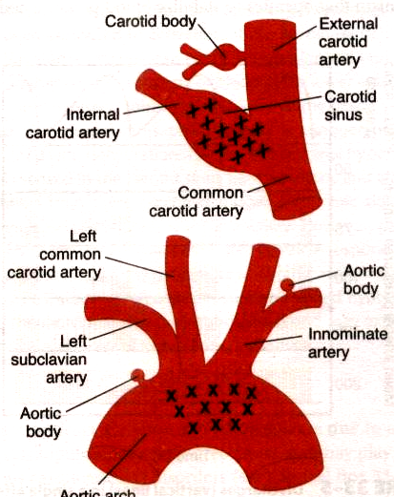
Baroreceptors
Respond to stretch
High pressure receptors in the
  Aortic arch
  Carotid sinus
Low pressure receptors
  Atria
  Pulmonary artery
  Pulmonary veins
Carotid
sinus
Aortic arch
viewed from behind

Slide 30
Tonic discharge rate from baroreceptors
  Increase BP
  Increased stretch of
  Baroreceptors
  Increases rate of
  Baroreceptors discharge
  Decrease BP
  Reduced stretch of
  Baroreceptors
  Reduced rate of
  Baroreceptors discharge
Afferents
Carotid sinus via carotid sinus nerve (branch of IX)
Aortic arch via aortic depressor nerve (branch of X)

Slide 31
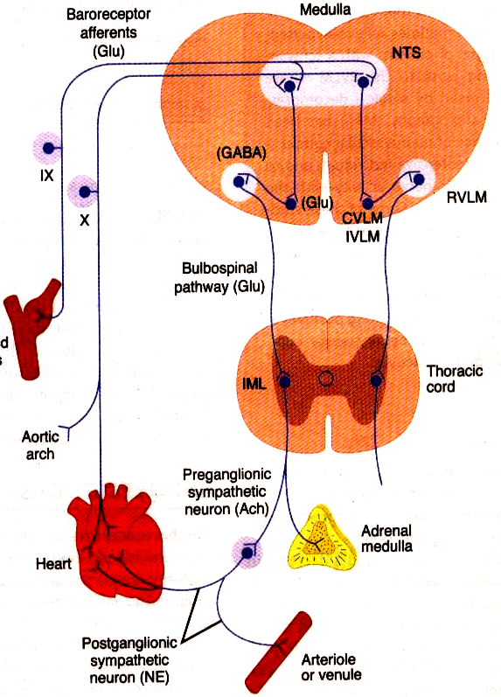
Medullary centres
Afferents enter nucleus of tractus solitarius
Glutamate
Excitation of the caudal ventrolateral medulla (CVLM)
GABA
Inhibition of the rostral ventrolateral medulla (RVLM) ‘vasomotor area’

Slide 32
Descending pathway
RVLM fibres descend in bulbospinal tract in the intermediolateral grey column of spinal cord

Slide 33
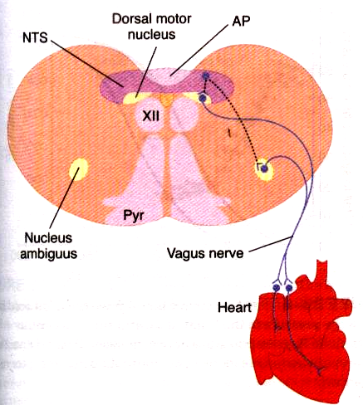
Vagal connections
NTS to vagal motor neurons
  Nucleus ambiguous
  Dorsal motor nucleus

Slide 34
Increased baroreceptors’ discharge
Reduction in sympathetic output to CVS
Increase in parasympathetic output to CVS
Heart- decreased HR &
Stroke volume
(→ reduced cardiac output)
Heart- decreased HR
(→ reduced cardiac output)
Vessels
Veins- reduced venous return
(→ reduced cardiac output)
Arterioles- reduced resistance
(→ reduced BP)

Slide 35
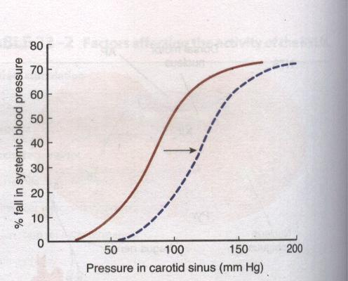
Baroreceptor resetting
Respond to pressures 60-180mmHg (best around 100mmHg)
Persistent increase causes resetting of baroreceptors

Slide 36


Slide 37
Direct afferents to RVLM
Chemoreceptors
  ↑ CO₂, ↓ O₂ stimulate discharge (i.e. Raise BP)
Cerebral cortex
  Rise in BP with emotions
Hypothalamus
Reticular formation
  Pain causes rise in BP
  (prolonged pain may cause fall in BP)
Vagal afferents from lung inflation
  (sinus arrhythmia)

Slide 38
Low pressure receptors
Atria, pulmonary arteries and veins
Respond to blood volume changes
Atrial stretch
  ↓
  Reflex vasodilatation
↓
Fall in BP
Fall in HR

Slide 39
Other CVS reflexes
Bainbridge reflex
Atrial stretch stimulates vagal afferents
Increases sympathetic discharge
Increases heart rate +/- contractility
CNS ischaemic response
Ischaemia of VMS or BP <60mmHg
Cushing’s reflex- raised intracranial pressure causes high BP and the baroreceptor reflex, a bradycardia

Slide 40
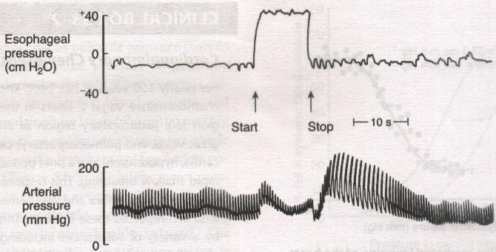
The Valsalva manoeuvre
Forced expiration against a closed glottis

Slide 41
Stage 1
  ↑Intrathoracic pressure adds to aortic pressure (rise in BP)
Stage 2
  ↑Intrathoracic pressure causes fall in VR, CO and BP
Stage 3
  Baroreceptors inhibited → rise in HR, TPR
Stage 4
  Glottis open and intrathoracic pressure normalised
  Peripheral vessels constricted → rise in BP

Slide 42
Self learning
What happens to the blood pressure when standing from a sitting position?
What is the main regulatory mechanism involved?

Slide 43
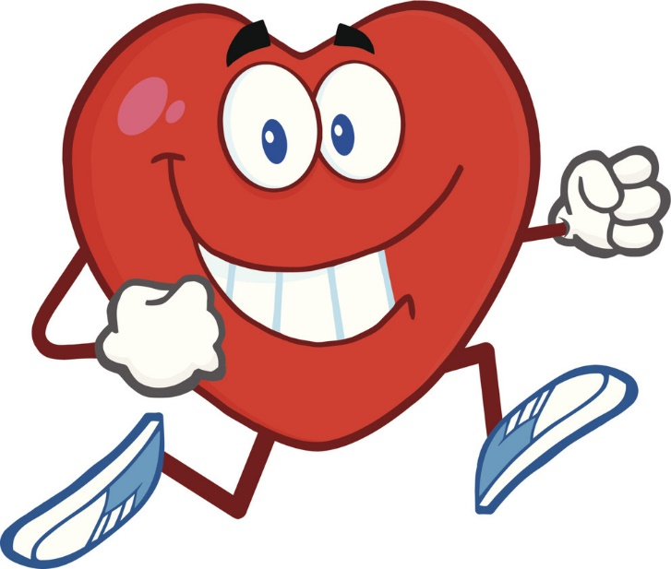
The End

